Slide 1
Fraud detection in Credit Card Transactions
- 20th July 2021
By:
Shreyas Gupta
B Sriharsh
K.S.V.L.Druthi

Slide 2
Table of Contents
Analysis of dataset(target variable)
Steps followed to implement the project
Preprocessing techniques used
Choosing the algorithm
Metrics to evaluate the performance of the prediction

Slide 3
Analysis of DataSet
The dataset provided to us had a log of 284,807 transactions which had details of the credit card holder, location of transaction, amount, time etc.
In order to protect the privacy of the credit card holder background details have been transformed into numerical input variables(v1-v28)
Feature 'Class' takes value 1 in case of fraud and 0 otherwise.
‘Time’
‘Amount’

Slide 4
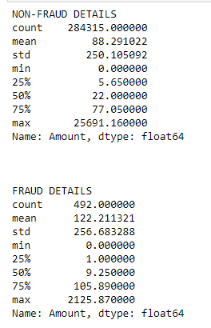
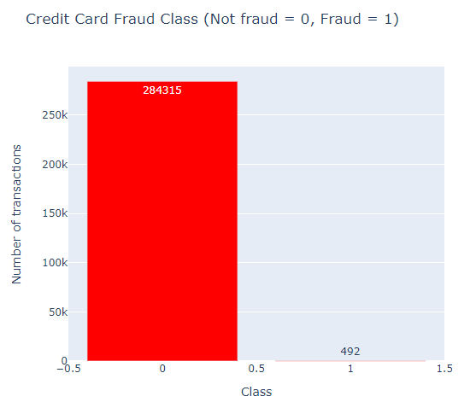
Analysis of DataSet

Slide 5
Pre-Processing
The first step is to load the dataset using the pandas library and print a summary of the dataset which includes number of data examples, mean amount transacted, most frequent time of transaction etc.
The next step is to check for missing values in the data and to see how many samples given are fraud vs not a fraud. Out of the 284,807 test samples only 492 of them were fraudulent, which is a really small percentage.
The next step is to split the data into training and test sets using the sklearn library. The test size chosen is 0.2, which means 80% of the data is used to train the model and 20% is used to test the model.
Time that was given in seconds was converted into hours

Slide 6
Choosing Algorithms
Random Forests
Logistic Regression
KNN

Slide 7
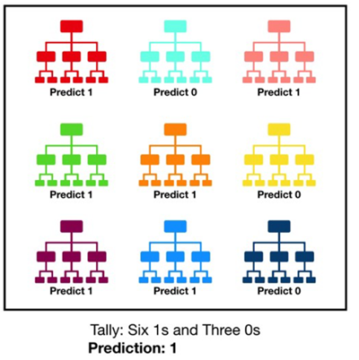
Random Forest
Consists of a large number of individual decision trees.
For a regression problem, the mean value is taken from the output of each individual tree and that is considered the final value
For a classification task, the most occurring value is treated as the final classification.

Slide 8
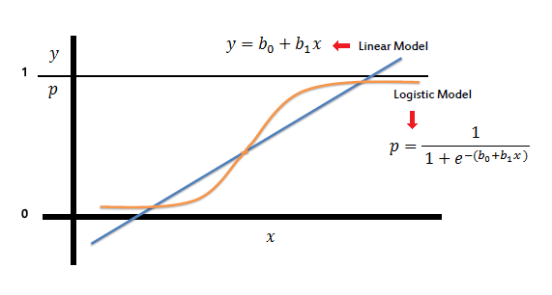
Logistic Regression
Logistic Regression is the go-to method for binary classification problems.
It deals with probability to measures the relationship between the dependent and independent variable.

Slide 9
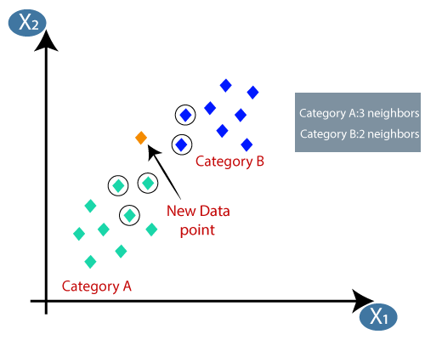
K Nearest Neighbour
K-Nearest Neighbour is a simple Machine Learning algorithm based on Supervised Learning technique.
In case of Classification a class label assigned to the majority of K Nearest Neighbors from the training dataset is considered as a predicted class for the new data point.
In case of Regression, the mean or median of continuous values assigned to K Nearest Neighbors from the training dataset is a predicted continuous value for our new data point.

Slide 10
Testing

Slide 11
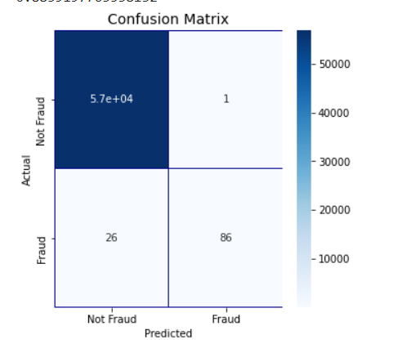
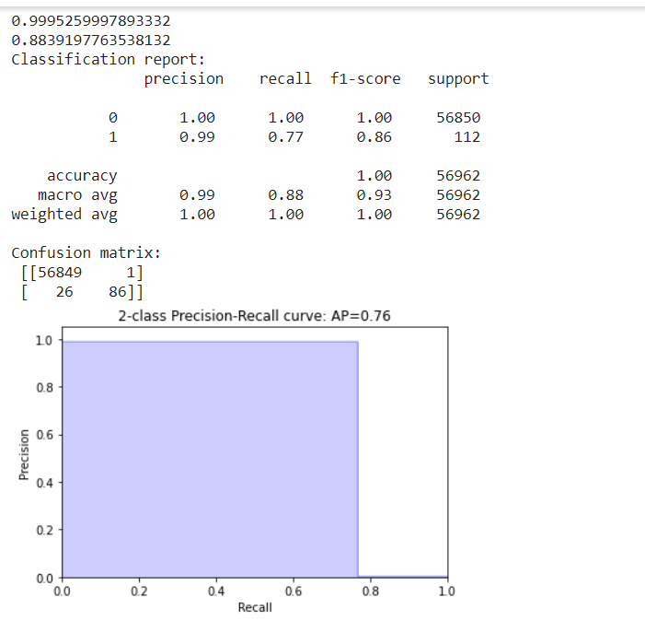
Evaluation of performance of chosen algorithms
Random Forest
Recall = 0.77. The rate of true positive in all true cases.
Precision = 0.99
F1-score = 0.86
True positives = 86,True negatives = 56849
False positives = 1,False negatives = 26

Slide 12
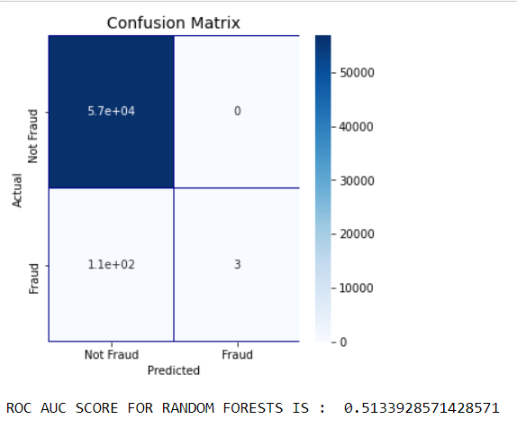
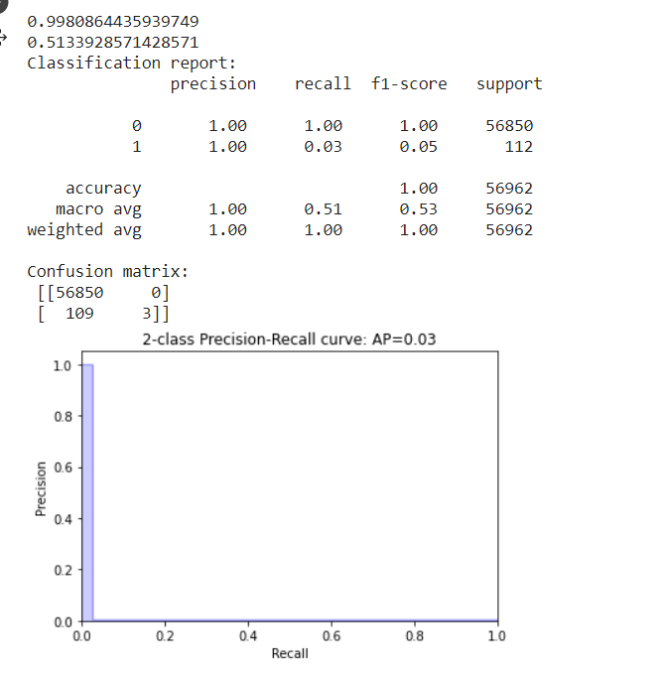
Evaluation of performance of chosen algorithms
KNN
Recall = 0.03. The rate of true positive in all true cases.
Precision = 1.00
True positives = 3,True negatives = 56850
False positives = 0,False negatives = 109

Slide 13
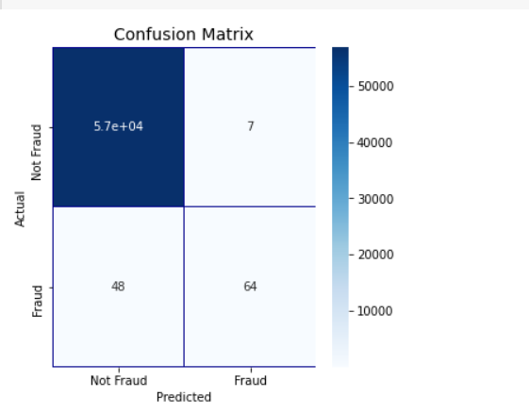
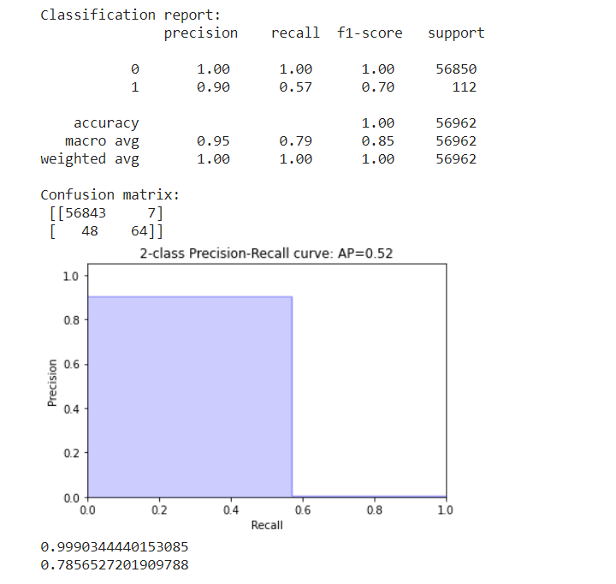
Evaluation of performance of chosen algorithms
Logistic Regression

